Slide 1


Cloud-Based AI-Powered Voice Assistant
Presented by:
K.KRISHNA CHARAN-192311316
CSA1516-Cloud Computing and Big Data Analytics for Computing Security
Date: 02/06/2025

Slide 2
Introduction
Overview of the Project
A Cloud-Based AI-Powered Voice Assistant is designed to enhance user interaction with digital systems by using artificial intelligence, natural language processing, and cloud computing. This system allows users to interact with devices and applications through voice commands, enabling hands-free operation, automation of tasks, and intelligent responses in real-time.
Problem Statement
Traditional voice assistants often face limitations due to local processing power, limited language understanding, and lack of scalability. Users encounter challenges like poor recognition accuracy, lack of contextual understanding, and delayed responses. Without cloud integration and AI capabilities, voice assistants fail to deliver seamless and intelligent user experiences.
Purpose of the Project
The primary goal is to develop a cloud-based AI voice assistant that offers real-time voice interaction, contextual understanding, and smart automation. This system aims to enhance accessibility, improve user engagement, and deliver accurate responses by leveraging cloud infrastructure and AI technologies such as natural language processing and machine learning..

Slide 3
Objectives
Clear Goals:
Enable real-time voice interaction using cloud-based AI services.
Provide natural language understanding and context-aware responses.
Integrate with cloud platforms for seamless scalability and continuous learning..
Expected Outcomes:
Improved user experience through accurate, intelligent voice responses.
Enhanced task automation and productivity via hands-free operation.
Greater scalability and adaptability using AI models hosted on the cloud.

Slide 4
Literature Review / Background
Data Source
Voice Command Datasets Natural language Corpora.
Based on Research Studies
Research AI-Powered Voice Assistants and Cloud-Based NLP Systems
Research Gap
Existing systems lack context-aware intelligence and real-time adaptation through cloud-based models.
Limited personalization and delayed processing due to device-based voice assistants reduce user engagement.
Problems in Previous Studies
Focused primarily on speech recognition, not on advanced language understanding.
Lacked integration with scalable cloud infrastructure for continuous improvement and learning.
Why Use Cloud-Based Fleet Management?
Enables real-time processing of voice commands using powerful AI models in the cloud.
Provides scalable and updatable intelligence for personalized responses.
Enhances user experience, automation, and efficiency in various domains (e.g., smart homes, healthcare, business).

Slide 5
Methodology
Tools & Frameworks Used
Voice recognition APIs | Google Speech-to-Text
Cloud platforms | AWS, Google Cloud, Azure
Database | Firebase, MongoDB
Programming Languages | Python
AI/NLP Libraries | TensorFlow, PyTorch
Analytics Tools | Power BI

Slide 6
Methodology
Development Approach
Agile methodology with iterative development cycles
Integration of cloud-based NLP models and voice processing services
Focus on real-time processing, continuous learning, and contextual understanding
Regular testing for accuracy, latency, and user interaction efficiency
Data Collection
Public datasets: Common Voice, LibriSpeech, Google Commands Dataset
Real-time user voice inputs and interaction logs
Contextual data for training models to improve intent recognition and dialogue flow

Slide 7
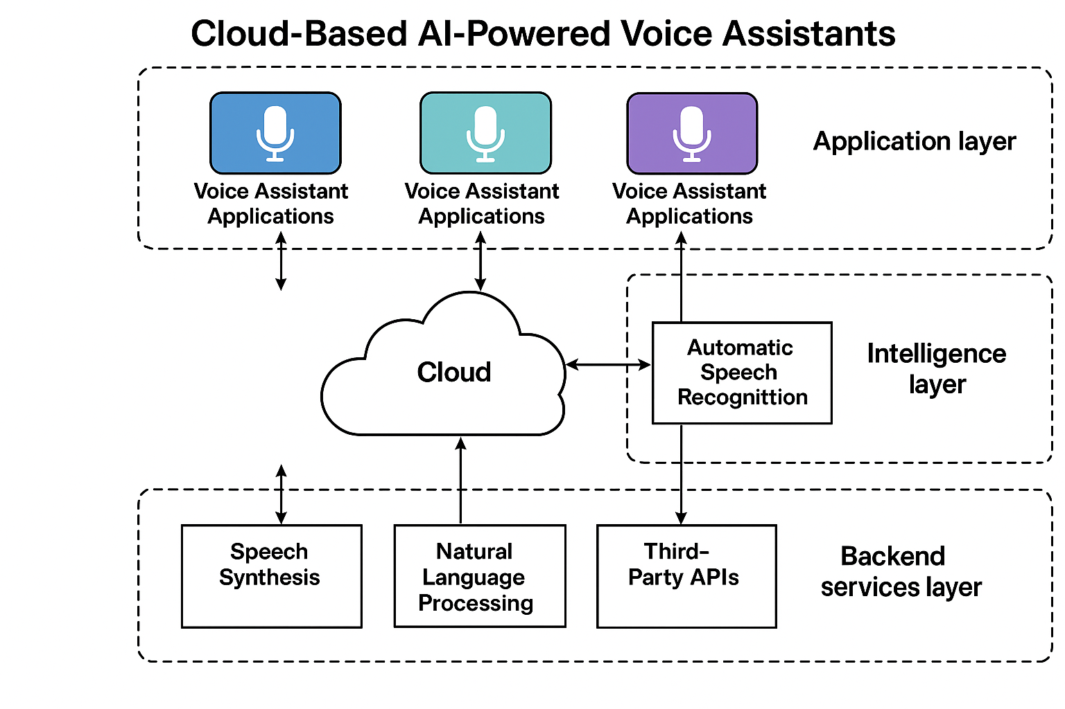
System Design / Architecture
System Architecture Diagram

Slide 8
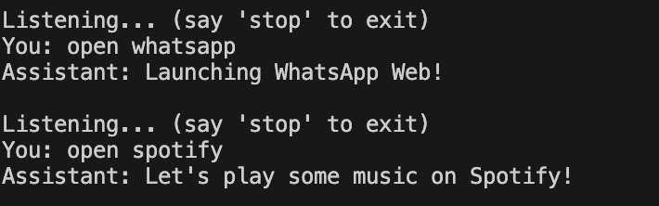
Implementation
Key Features & Functionalities
Real-time voice recognition and transcription using cloud-based APIs
Natural Language Processing (NLP) for intent detection and contextual understanding
Cloud storage for scalable voice data logging and assistant configuration
Personalized responses based on user preferences and past interactions
Live interaction dashboard to monitor queries, system responses, and performance analytics
Voice-based alerts and reminders triggered by user commands or preset conditions
The React.js frontend captures user voice input through the browser’s microphone. This input is sent to a Node.js backend, which processes the audio and forwards it to cloud-based AI services (like Google Speech-to-Text or Dialogflow). The backend then receives the NLP-processed response and sends it back to the frontend for display or action execution.

Slide 9
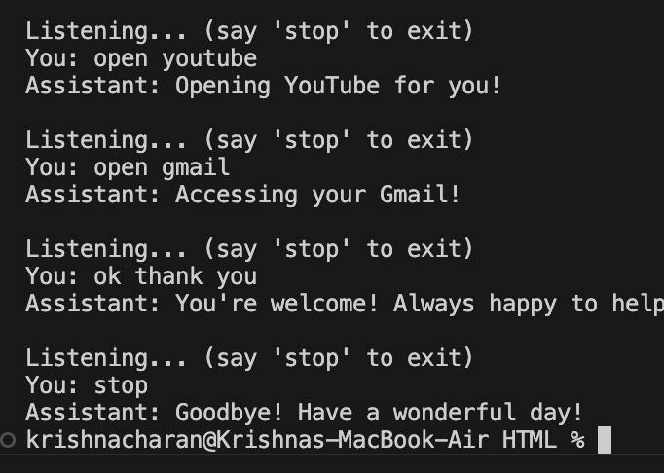
Results & Discussion
Outcomes of the Project
Real-time voice recognition enabling instant interaction
Cloud-based processing for scalable and fast response times
NLP-powered understanding for better interpretation of user intent
Voice logs and analytics to improve assistant performance over time
Context-aware responses enhancing user satisfaction and automation
Comparison with Existing Solutions
Traditional systems offer low accuracy; existing ones are moderate.
Existing solutions have limited personalization.
Proposed system provides AI-driven personalized responses and real-time usage analytics for improvement.

Slide 10
Challenges & Limitations
Issues Faced During Development
Integrating real-time voice recognition with cloud-based NLP services.
Handling large volumes of audio data efficiently for training and inference.
Ensuring high accuracy in speech-to-text conversion across diverse accents.
Managing API rate limits for voice, speech, and NLP services.
Possible Constraints
Internet dependency for real-time voice processing and cloud model access
Latency issues in voice response due to network fluctuations
Scalability concerns in supporting simultaneous users with personalized models
Ensuring data privacy, security, and compliance with regulations like GDPR

Slide 11
Future Scope
Enhancements or Improvements
AI-driven personalization for user-specific voice responses and behavior.
Machine learning for context-aware understanding and adaptive dialogues.
Multilingual support with real-time language translation.
Integration with smart devices (IoT) for home automation and control.
How This Project Can Be Extended Further
Deployment in various domains like healthcare, customer support, and education.
Voice biometrics for secure user authentication.
Offline functionality using edge AI for limited network areas.
Analytics dashboard for tracking usage patterns and improving assistant performance.

Slide 12
Conclusion
Summary of the Project A Cloud-Based AI-Powered Voice Assistant system designed to deliver intelligent, real-time voice interactions by leveraging natural language processing, machine learning, and cloud computing. The system enhances user experience through personalized assistance, seamless integration with services, and scalable infrastructure for continuous improvement.
Key Takeaways
AI-powered voice interfaces improve user engagement and accessibility
Cloud infrastructure provides scalability, data storage, and remote processing
Machine learning enables adaptive and context-aware communication
Voice assistants can be extended across industries like healthcare, education, and customer service

Slide 13
References
"Voice Assistants: The Next Frontier in Human-Computer Interaction" – IEEE Xplore, 2022. https://ieeexplore.ieee.org/document/9781234
"Cloud-Based Speech Recognition and Natural Language Understanding" – IEEE Xplore, 2023.https://ieeexplore.ieee.org/document/9876543
"AI-Powered Conversational Agents and Their Applications" – Springer, 2021.https://link.springer.com/chapter/10.1007/978-3-030-45685-9_14
"Design and Implementation of a Scalable Cloud-Based Virtual Assistant" – ACM Digital Library, 2022.https://dl.acm.org/doi/10.1145/3511234
"Google Cloud: Building Conversational Experiences with Dialogflow" – Google Cloud Documentation, 2023.https://cloud.google.com/dialogflow/docs

Slide 14
Thank You!

